Slide 1

The Clinical Iceberg

Slide 2

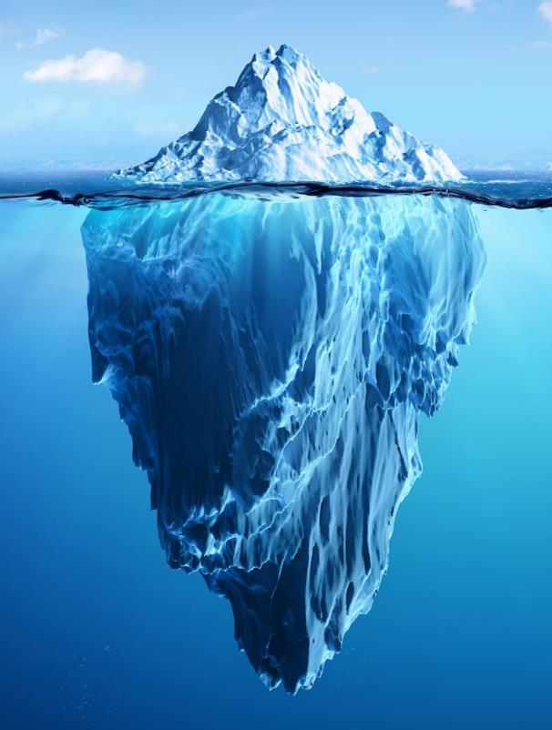
The Iceberg Idea
When we look at an iceberg we only see the part which is above the water.
But MOST of the iceberg (about nine tenths) is under the surface.

Slide 3
The Clinical Iceberg
Doctors use the iceberg idea to help them think about different illnesses and conditions.
They call this the ‘clinical iceberg’

Slide 4
Below the surface
For any illness or condition, MOST people are below the surface – they may only have mild symptoms or they will recover from their symptoms on their own.
The human body is generally very good at keeping itself in balance.

Slide 5
Above the surface
Only the few people above the surface are the ones who have severe symptoms and require treatment from a doctor or a nurse or have to go in to hospital.

Slide 6
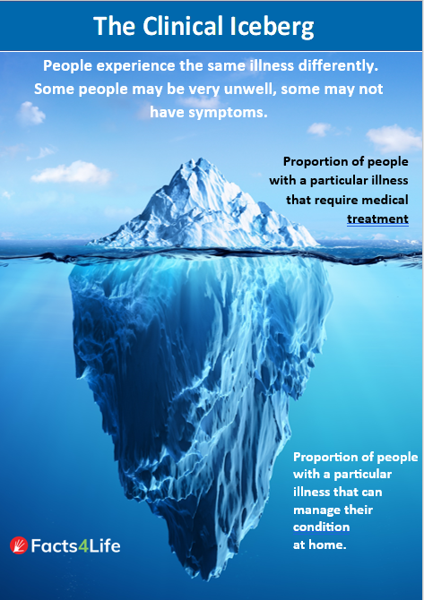

Slide 7

The common cold - above the surface
The common cold doesn’t usually cause serious symptoms so most people would be in the part of the iceberg below the surface.
Q: What are the different symptoms of a common cold?
How might they differ from person to person?

Slide 8
The common cold - below the surface
The common cold doesn’t usually cause serious symptoms so only a very small amount of people would be in the part above the surface.
Q: Why might some people need treatment if they catch a cold?

Slide 9

Pushing the iceberg down
To help prevent the spread of diseases so that fewer people are ill, there are things we can do to help ‘push the iceberg down’
What sort of things help to prevent the spread of a disease like the common cold?

Slide 10
The Iceberg Idea
Use the iceberg idea to think about these different conditions and illnesses. Think about the people above and below the surface.
allergies
asthma
influenza
chicken pox

Slide 11
Healthy Lifestyles
Discuss:
What impact do these things have on our health and our ability to cope with diseases.

Slide 12
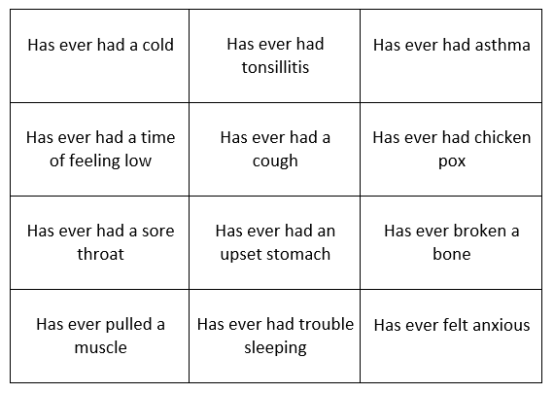
Health Bingo

Slide 13
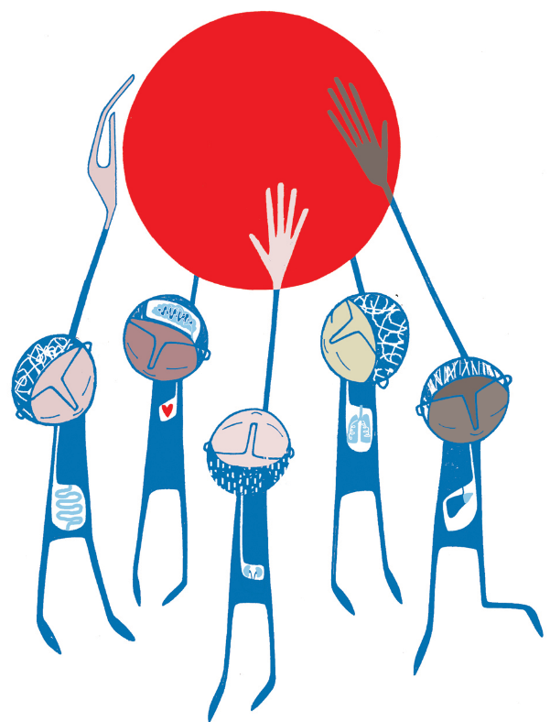
The MOST Message
MOST of the time,
MOST people get better from
MOST illnesses on their own

Slide 14

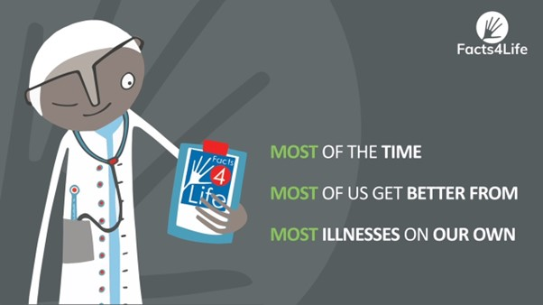
Most Idea

Slide 15
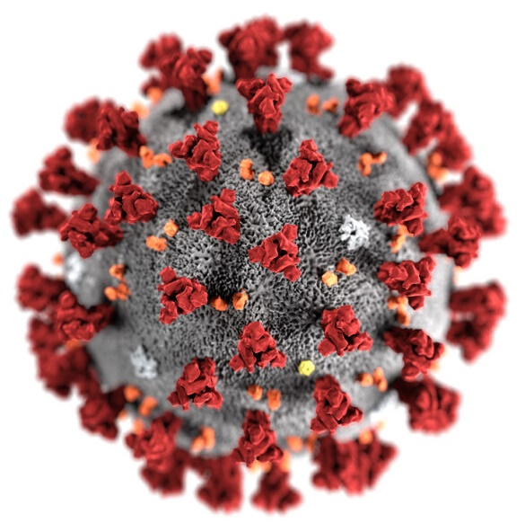
COVID-19 and the clinical iceberg

Slide 16




www.facts4life.org

