Slide 1

Reflection and Next Steps

Slide 2

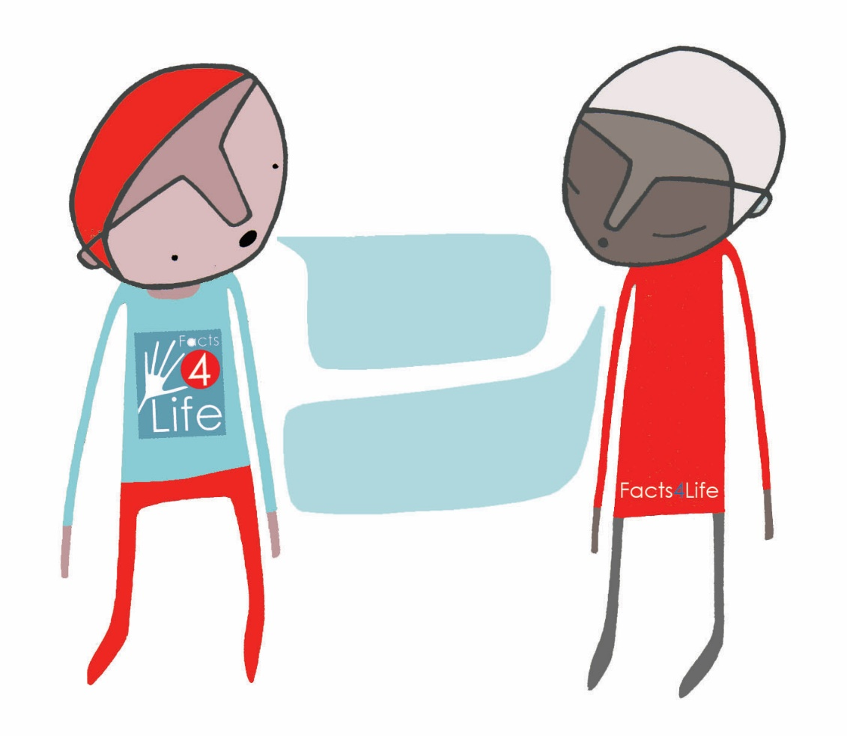
DISCUSSION IN GROUPS
                What benefits do you identify for children in adopting Facts4Life resources?
                How does this approach fit with your current curriculum?
                Next steps for your setting?
Notes:
grey = #5C6462
yellow = #F5C80B
blue = #094C86

Slide 3




www.facts4life.org

