Slide 1


Slide 2




KEY THEMES RECAP
Riding the Ups and Downs
Keeping
Balanced
Smoothing the Path

Slide 3



Slide 4
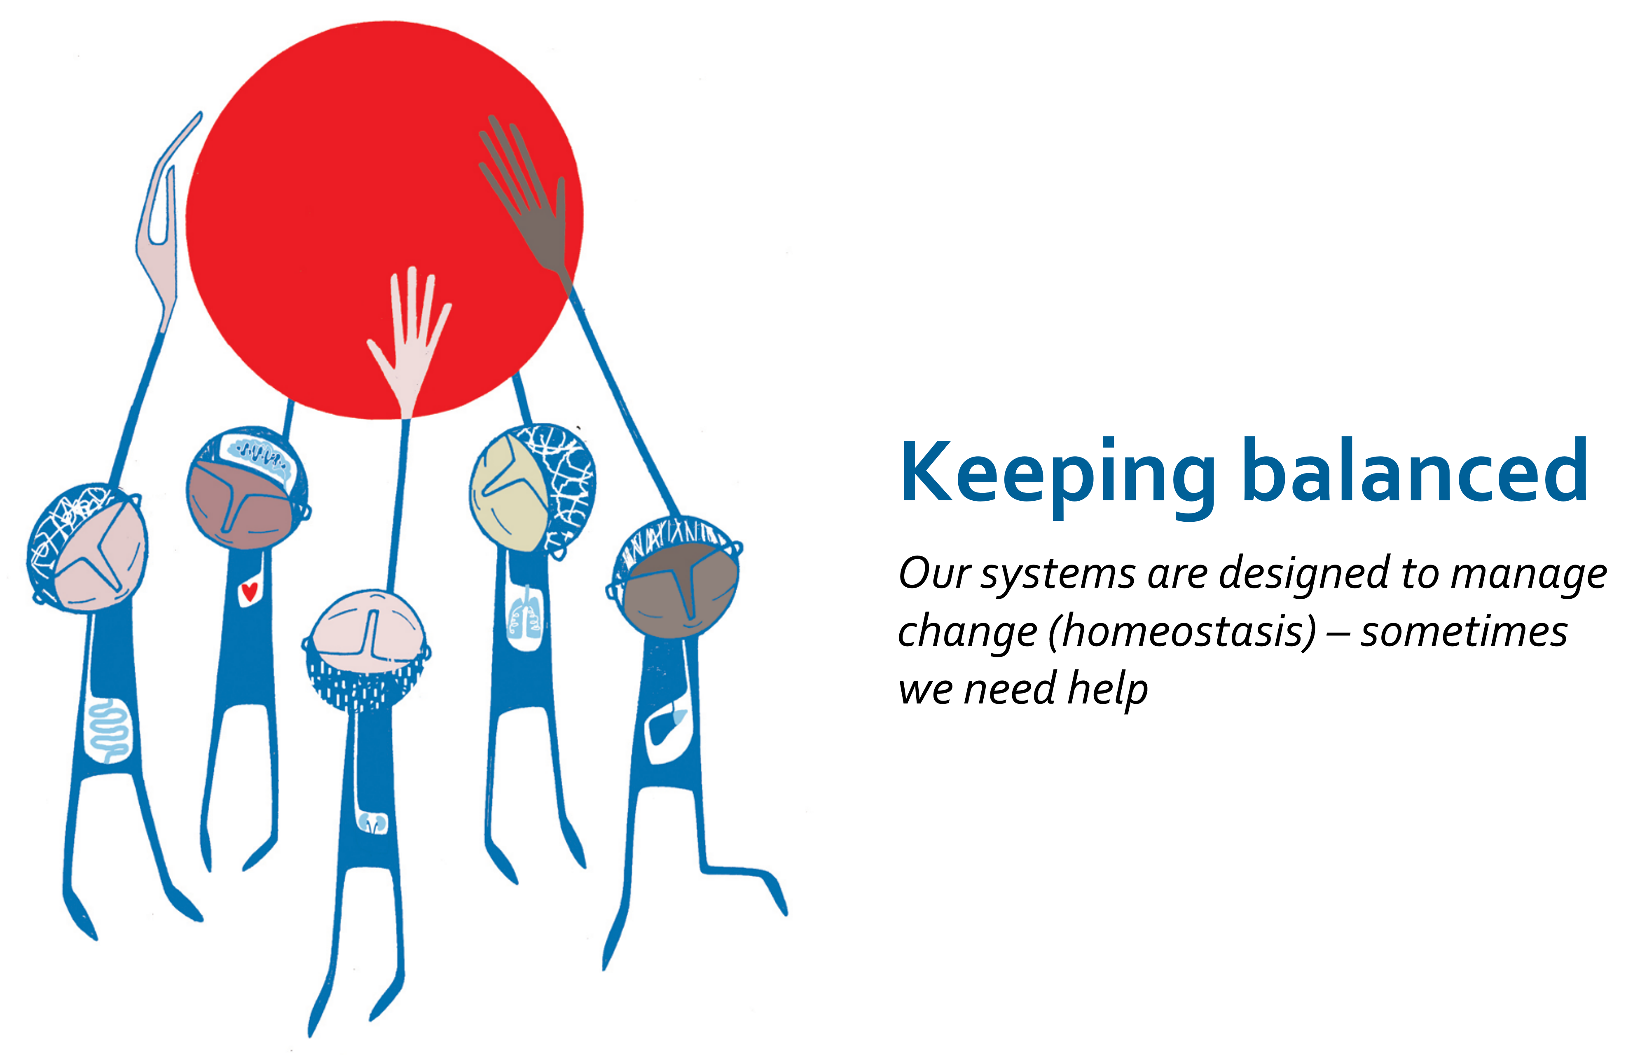

Slide 5


Slide 6




www.facts4life.org

